Slide 1



The 5 Phases of the Cloud SLA Lifecycle
A Comprehensive Guide to Contract Definition, Publishing, Negotiation, Operationalization, and De-commissioning in Cloud Computing

Slide 2
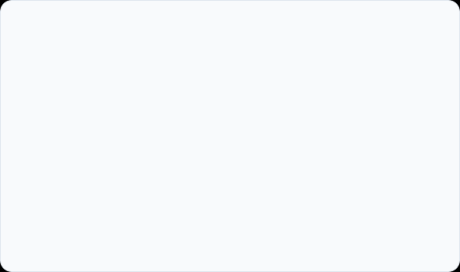
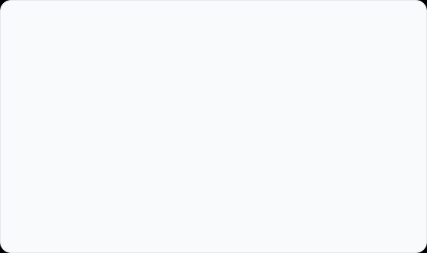
Understanding Cloud SLAs
What is a Cloud SLA?
The Lifecycle Management Need
A Service Level Agreement (SLA) is a formal, legally binding agreement between a cloud service provider (CSP) and consumer defining non-functional service requirements.
Cloud environments are inherently dynamic. Static agreements are insufficient for virtualized, multi-tenant infrastructures requiring runtime flexibility.
Establishes Quality of Service (QoS) obligations.
Standardizes contract generation and discovery.
Defines availability, latency, throughput, and security targets.
Enables dynamic runtime monitoring & automated scaling.
Includes financial remedies for contract violations.
Ensures orderly termination and compliance settlement.

Slide 3
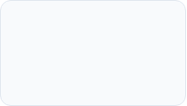
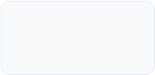
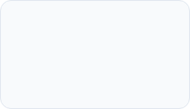
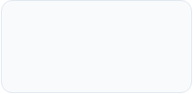
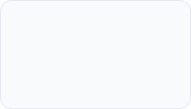
Overview of the 5 Lifecycle Phases
4. Operation
2. Publishing
Runtime monitoring, accounting, and enforcement.
Advertising SLA templates in searchable catalogs.
1. Definition
3. Negotiation
5. De-commission
Drafting standard service templates and QoS parameters.
Bidding and customizing specific contract terms.
Resource release, data cleanup, and final settlement.

Slide 4


Phase 1: SLA Contract Definition
The provider establishes standard service templates, metrics, and remedies prior to offering services to the market.
Service Level Indicators (SLIs): Specific metrics to track (e.g., uptime %, CPU throughput, network latency).
Service Level Objectives (SLOs): Numeric targets for indicators (e.g., 99.99% availability, <30ms delay).
Penalty Credit Formulas: Defined financial compensation (e.g., 10% credit per hour of downtime).

Slide 5
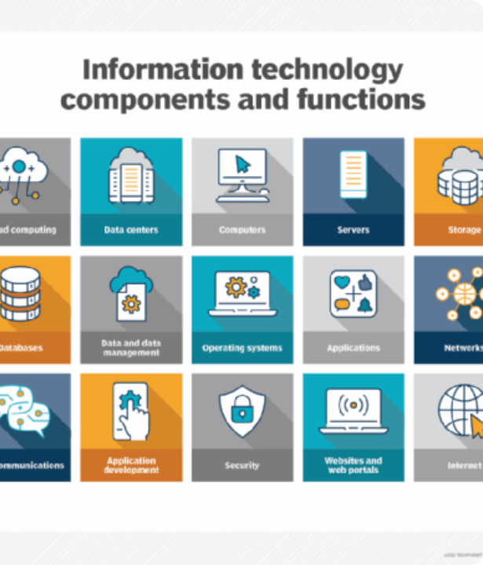
Phase 2: Publishing & Discovery
Catalog Publishing
Providers publish standard SLA templates into public, private, or federated service registries and digital marketplaces.
Consumer Discovery
Consumers search directories to identify providers offering SLAs that align with workload performance, security, and budget requirements.

Slide 6

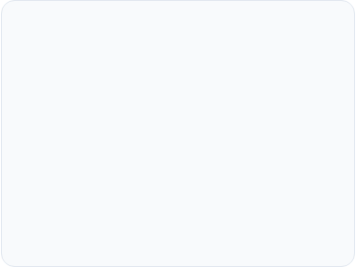
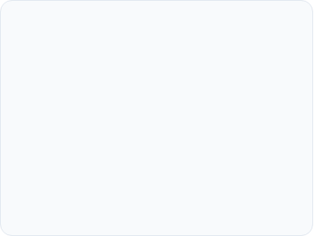



Phase 3: SLA Negotiation
1. Bidding & Matchmaking
2. Customization
3. Contract Signing
Automated software agents or portal interfaces exchange resource requirements and pricing offers between parties.
Tailoring standard template clauses for enterprise clients requiring higher uptime guarantees or specialized compliance terms.
Finalizing terms into a cryptographically verified, legally binding digital SLA contract ready for execution.

Slide 7
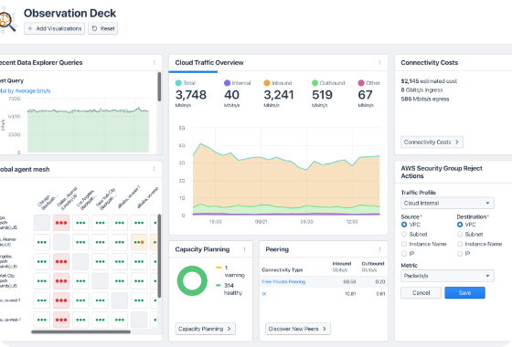
Phase 4: Operationalization & Monitoring
Operationalization turns the negotiated SLA into active runtime tracking and resource provisioning:
Service Deployment: Instantiating VMs, containers, and network routes according to contract specification.
Real-time Telemetry: Continuous monitoring of CPU utilization, packet loss, and response latency.
Auditing & Logging: Immutable tracking of metric history to verify compliance during billing cycles.

Slide 8
Phase 4: SLA Enforcement & Remediation
Proactive SLA Management
Violation Handling & Remedies
Automated cloud management software prevents violations before they disrupt services.
When an SLA breach occurs, automated rules enforce defined penalty procedures.
Auto-scaling compute instances when load spikes exceed thresholds.
Automated logging of exact breach timestamp and duration.
Calculation of financial penalty credits applied to client invoice.
Live migration of virtual machines to healthier hypervisors.
Dynamic bandwidth throttling and priority queueing.
Triggering root-cause analysis alerts for engineering teams.

Slide 9
Phase 5: De-commissioning
Resource Deprovisioning: Orderly termination and reclamation of virtual machines, storage volumes, and network allocations upon contract expiration or cancellation.
Secure Data Sanitization: Rigorous wiping and cryptographic erasure of tenant data across shared physical hardware to comply with privacy regulations (GDPR, HIPAA).
Final Financial Settlement: Reconciliation of total usage, penalty credits, and outstanding balances before issuing the final closing statement.
Compliance Archiving: Preserving historical audit logs and contract records for required regulatory retention periods.

Slide 10
Cloud SLA Lifecycle Summary Matrix
Phase | Primary Focus | Key Operations | Primary Output
1. Definition | Standardization | Define SLOs, SLIs, and penalty schemes | SLA Template
2. Publishing | Market Exposure | Register templates in service registries | Catalog Listing
3. Negotiation | Agreement | Match offers, customize terms, sign contract | Binding Contract
4. Operation | Execution | Real-time telemetry, auto-scaling, penalty claims | Compliance Logs
5. Termination | Off-boarding | Data sanitization, resource release, settlement | Final Audit & Receipt

Slide 11
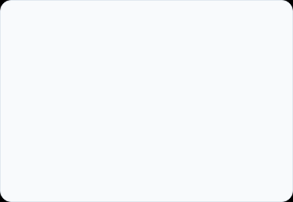
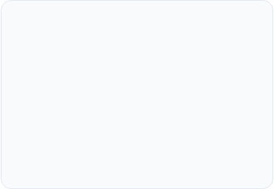
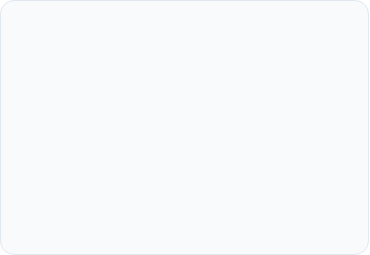
Best Practices for SLA Management
Measurable Metrics
Automation First
End-to-End Security
Ensure all Service Level Objectives are clear, unambiguous, and independently verifiable with automated monitoring tools.
Leverage automated agents for SLA negotiation, monitoring, and proactive auto-scaling to minimize human intervention.
Incorporate data protection, compliance standards, and secure data destruction mandates explicitly into every phase.

Slide 12

Questions & Answers
Thank you for your time and attention.
cloud-architecture.org
|
contact@cloud-architecture.org

Slide 13



Image Sources
https://stl.tech/wp-content/uploads/2023/02/Building-infrastructure-1-1-1.jpg
Source: stl.tech
https://www.techtarget.com/rms/onlineimages/data_center-info_tech_components_and_functions-f_mobile.png
Source: www.techtarget.com
https://images.ctfassets.net/6yom6slo28h2/61sxKAjYcmvjpxR0TYeXzR/0263c3c38a7fd4d4c7120c403e3252a1/observation-deck.png?q=80
Source: www.kentik.com

